Slide 1
Chapter 13
Reliability Testing
13.1 Product Testing
13.2 Reliability Life Testing
13.3 Test Time Calculations
13.4 Burn-in & screen testing
13.6 Accelerated life testing
Notes:
Failure data is obtained primarily by collecting failure times of those products that are in use or through reliability testing. This chapter and the next address several different types of reliability testing. In general, the objective of reliability testing is to generate failures. It is only through failure data that reliability can be measured and many of the failure modes identified.

Slide 2
Test Design
Test objective
  e.g. reliability demonstration, reliability improvement, screening
Type of test
  e.g. sequential, accelerated
Operating & environmental conditions
Number of units to be tested (sample size)
Duration of test
  failure terminated vs time terminated
Definition of a failure
Chapter 13
Notes:
In establishing a reliability test program, the test objective, the conduct of the test, and the analysis methods to be used should be determined in advance.

Slide 3
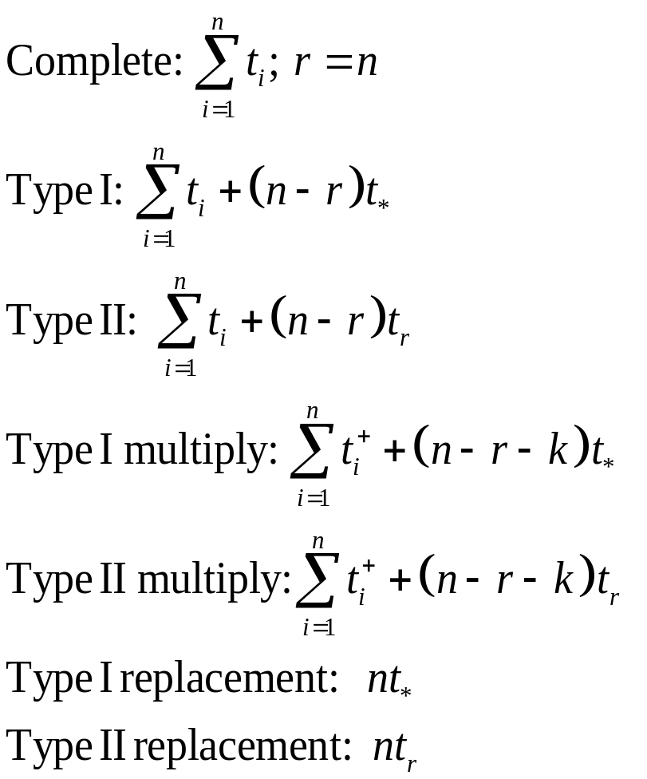
Cumulative Time on Test - CFR
n = nbr on test
r = nbr failures
k = nbr multiply
censors
t_{i} = failure time
t_{i}⁺ = censor time
t* = test time (Type I)
t_{r} = test time (Type II)
MTTF = T / r
Chapter 13
Notes:
The above table provides the total time on test, T, under different test conditions. For exponential failure times, the maximum likelihood estimate (MLE) for the MTTF is then given by T/r where r is the number of observed failures. MLE will be discussed further in Chapter 15.

Slide 4
Example 13.1
During a testing cycle, 20 units were tested for 50 hours with
the following failure times and censor times observed:
10.8, 12.6+, 15.7, 28.1, 30.5, 36.0+, 42.1, 48.2
For Type I testing with t* = 50 hours as the test termination time,
T = 10.8 + 12.6 + 15.7 + 28.1 + 30.5 + 36.0 + 42.1
+ 48.2 + (20 - 6 - 2) 50 = 824 hours
Then MTTF = 824/6 = 137.3 hours.
Chapter 13
Notes:
An example of finding the MTTF for right censored data.

Slide 5
Example 13.2
Ten units were placed on test with a failed unit immediately
replaced. The test was terminated after the 8th failure which
occurred at 20 hours.
This is type II testing with replacement. Therefore
T = (10) (20) = 200 hours
MTTF = 200/8 = 25 hours
Chapter 13
Notes:
Another example where failed units are replaced during testing.

Slide 6
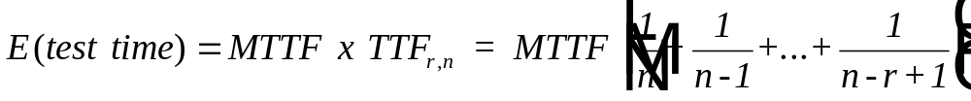
Length of Test - Type II Testing - CFR
with replacement:
E(test time) = r x MTTF / n
without replacement:
TTF_{r,n}
Chapter 13
Notes:
For exponential failure times under Type II testing, the expected duration of the test can be estimated if an estimate for the MTTF is known. The expected test time is the average time to generated r failures.
With replacement, the number of failures in time t is Poisson with mean n λ t, then setting r = n λ t = n t / MTTF and solving for t results in the above equation.
The derivation of the expected test time without replacement is given on the next slide.

Slide 7
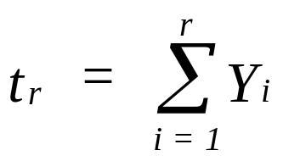
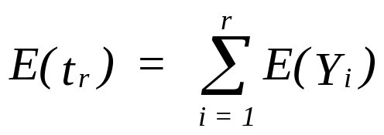
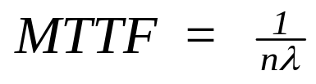
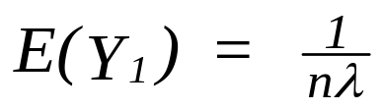
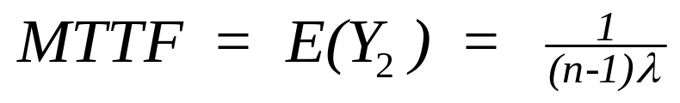
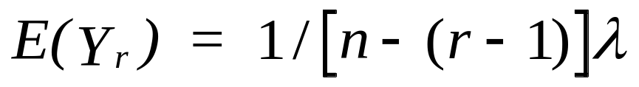
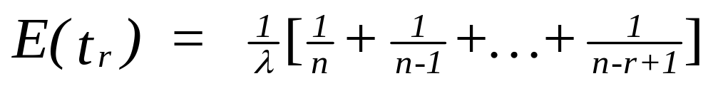
TTF_{r,n}
Y_{i} = t_{i} – t_{i-1} where t_{i} is the time of the ith failure.
is the time of the rth failure
is the expected time of the rth failure
and
with n identical units operating
after the first failure
after r-1 failures
Chapter 13
Notes:
The above outlines the derivation of the expected test time without replacement.

Slide 8
Example 13.3
n r TTFn,r
0 1 0.100
10 2 0.211
10 3 0.336
10 4 0.479
10 5 0.646
10 6 0.846
10 7 1.096
10 8 1.429
10 9 1.929
10 10 2.929
11 1 0.091
11 2 0.191
11 3 0.302
11 4 0.427
11 5 0.570
11 6 0.737
11 7 0.937
11 8 1.187
11 9 1.520
11 10 2.020
11 11 3.020
To support the current cycle in a reliability
growth testing program, a total of 8 failures
need to be generated. The current estimate
of the MTTF is 55 hours. The test
department is scheduled to complete testing
within 72 hours. How many units should
be placed on test?
This is Type II testing. Since the length of
the test is MTTF x TTF then the
TTF_{8,n} = 72/55 = 1.31. From the table,
TTF8,10 = 1.429
TTF8,11 = 1.187
Chapter 13
Notes:
An example of finding the number of units to place on test, n, in order to generate r failures in a specified time. In this example, there is no replacement of failed units and the table in Appendix 13B is utilized.

Slide 9
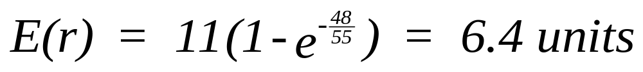
Example 13.4
For the problem in Example 13.3, the test department is told
they must complete the testing within 48 hours. How many
failures would they expect to generate?
Chapter 13
Notes:
This is an example of Type I testing where the test time t is specified. Since the probability of a single unit failing in time t is F(t), the n F(t) is the expected number of failures.
note: This can be viewed as binomial process where the constant probability of success is p = F(t) and there are n independent trials corresponding to each unit on test. The mean of a binomial process is n x p.

Slide 10
Burn-in Testing
Goal is to increase the mean residual life
Eliminate “early” customer failures by generating test hours in the factory
There must be a dominate DFR failure mode
Primary question is how long to test?
  Specification model
  cost model
Chapter 13

Slide 11
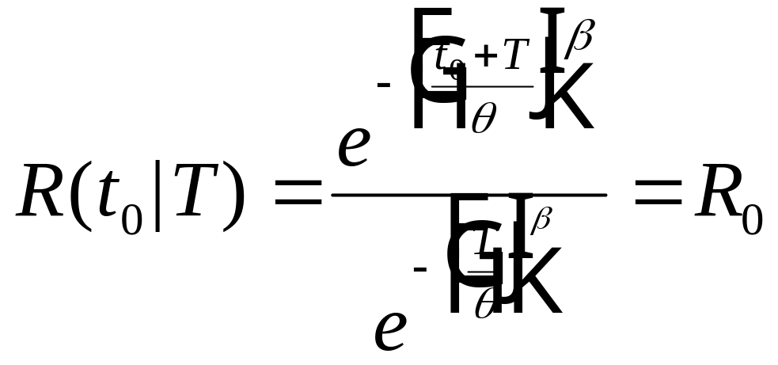
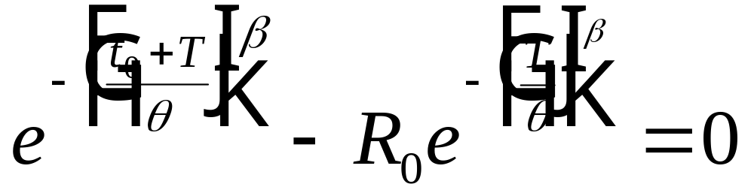
Burn-in Testing Specification Model
Given a reliability goal of R₀ where R(t₀ ) < R₀ and R(t) has a DFR,
then a burn-in period, T, is desired such that R(t₀ | T) = R₀.
For the Weibull distribution
Chapter 13
Notes:
Burn-in testing puts operating time on a product before the product is delivered to the customer. The objective is to identify early (burn-in) failures and eliminate them before the product is delivered to the customer. Therefore the reliability from the customers perspective is improved.
The above model can be used to find a burn-in time, T, such that the reliability over some additional time t₀, equals R₀. This is achieved by setting R(t₀| T) = R₀ and solving for T. A necessary requirement is that the product (or at least the dominate failure mode) has a decreasing failure rate. A specific model using the Weibull distribution is shown.

Slide 12
Burn-in Testing
burn-in failures
f(t)
operating
failures
R(t₀)<R₀
t₀
T
t
Chapter 13
Notes:
Burn-in testing does not increase the overall product reliability but does reduce the probability of a failure following the burn-in period (i.e. the operating period).

Slide 13
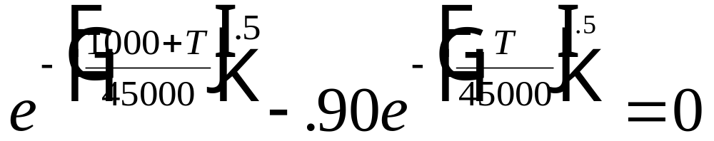
Example 13.5
Reliability testing has shown that a ground power unit used to
supply DC power to aircraft has a Weibull distribution with beta = .5
and theta = 45,000 operating hours. Determine a burn-in period
necessary to obtain a required reliability specification of R(1000) = .90.
Observe that R(1000) = .86 and beta< 1.
T* = 126 hr. and R(1000|126)= 0.90
Chapter 13
Notes:
An example based upon the Weibull burn-in model. The solution for T can be found by trial and error.

Slide 14
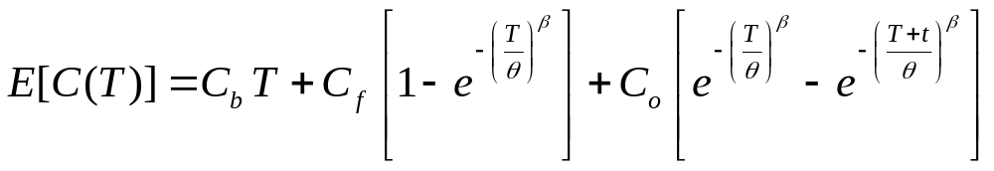
Burn-in Testing - Cost Model
C_{b} = cost per unit time for burn-in testing
C_{f} = cost per failure during burn-in
C_{o} = cost per failure when operational
T = length of burn-in testing
t = operational life of the units
E[C(T)] = C_{b} T + C_{f} [ 1 - R(T)] + C_{o} [ R(T) - R(t+T) ]
for the Weibull:
Chapter 13
Notes:
A burn-in model based upon relevant costs is derived here. Costs include the cost of performing burn-in testing, the cost of failures during burn-in, and the cost of failures during the operating period. Again, the unknown variable is the length of the burn-in period, T. A specific cost model for the Weibull failure distribution is given.

Slide 15
Example 13.6
The replacement cost on a new product if it fails during its
operational life of 10 years (3650 days) is $6200. It will cost
the company $70 a day per unit tested to operate a burn-in
program and any failures during burn-in will cost $500.
Reliability testing has established the life distribution of the
product to be Weibull with beta = .35, and theta = 3500 days.
What is the minimum cost time period for the burn-in?
T* = 1.9 days with E[C(T)] = $ 3690
Chapter 13
Notes:
An example of the Weibull burn-in cost model. The solution can be found using a spreadsheet and trial and error.

Slide 16
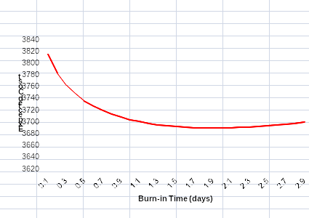
Example 13.6
T = 0, E[C(T)] = $3952
E[C(T)] = $3704
E[C(T)]=$ 3690
Chapter 13
Notes:
A graph of the cost equation is relatively flat in the neighborhood about the minimum cost solution. This suggests that the burn-in period may be shortened without a significant increase in cost. This may be desirable if other factors, such as production lead-time, must be considered. However, when compared to the cost of having no burn-in testing program, a significant saving per unit is observed.

Slide 17
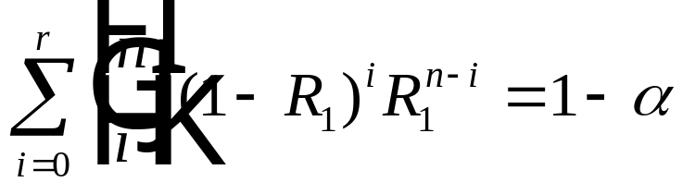
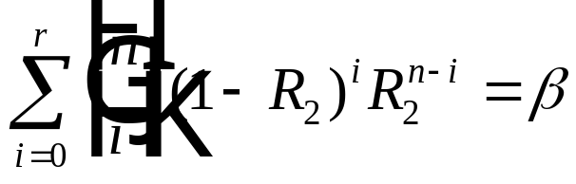
Binomial Acceptance Testing
The objective is to demonstrate that the system reliability at time T is R₁ (i.e. R(T) = R₁ ).
n units are placed on test with X failures observed by time T.
If X ≤ r, then the desired reliability is demonstrated; otherwise, it is concluded that R(T) < R₁.
Test plan is based upon specifying the sample size n and the maximum number of failures, r, for acceptance.
Pr{X ≤ r | R = R₁ } = 1- α and Pr{X ≤ r | R = R₂ } = β
Chapter 13

Slide 18
Binomial Acceptance Testing
Selected Reliability Acceptance Plans
R₁ | R₂ | n | r | 1-α | β
.99 | .90 | 50 | 2 | .986 | .111
.99 | .90 | 60 | 2 | .978 | .053
.99 | .90 | 70 | 3 | .995 | .071
.95 | .89 | 150 | 11 | .926 | .091
.95 | .89 | 175 | 13 | .942 | .077
.98 | .92 | 100 | 4 | .949 | .090
.98 | .92 | 120 | 5 | .966 | .075
.95 | .85 | 75 | 6 | .919 | .054
.95 | .85 | 100 | 9 | .972 | .055
.96 | .92 | 250 | 14 | .921 | .095
.96 | .92 | 275 | 15 | .912 | .069
.995 | .95 | 90 | 1 | .925 | .057
.995 | .95 | 120 | 2 | .977 | .058
Chapter 13

Slide 19
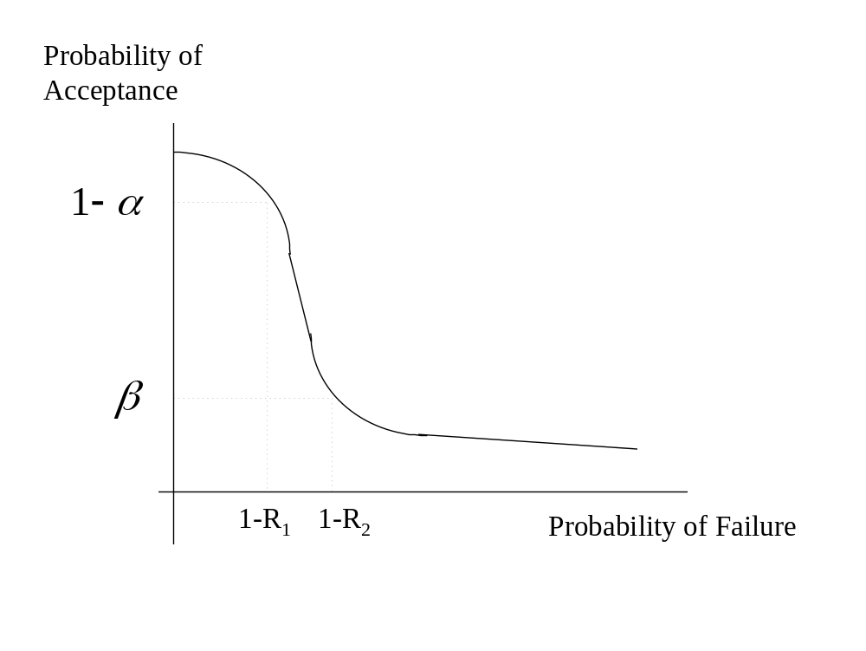
Operating Characteristic Curve
Chapter 13

Slide 20
Accelerated Life Testing
Problem: test time < expected lifetimes
Solution:
Increase the number of units on test (compressed time)
Accelerate the number of cycles per unit of time
Increase the stresses that generate failures (accelerated stress testing)
Chapter 13
Notes:
When component time to failure is relatively long and and testing to failure is desired, ways may need to be found to shorten the “clock” time necessary to generate failures. There is, in general, three ways of accomplishing this. The use of these techniques is referred to as accelerated life testing.

Slide 21
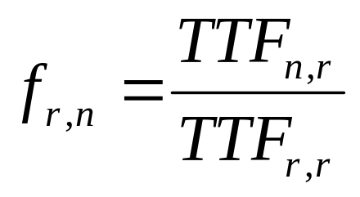
Increase Number of Units on Test
For CFR:
without replacement
f_{r,n} = r/n with replacement
then
f_{r,n} is the factor reduction in expected test time
100(1-f_{r,n}) is the percent savings in expected test time
Chapter 13
Notes:
The formulae derived earlier for relating the expected test time to the number of units on test and the number of desired failures can be used to estimate the number of units to be placed on test to achieve a desired test time. Since these formulae were derived for the CFR, they do not directly apply for other failure distributions. However, the modifications shown for the Weibull, provide a reasonable approximation. The baseline (denominator) is testing until all units have failed (complete data).

Slide 22
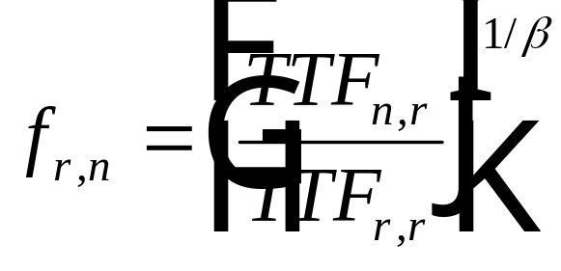
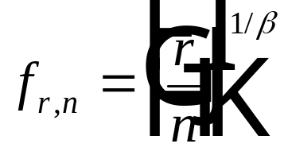
Increase Number of Units on Test
for Weibull:
without replacement
with replacement
then
f_{r,n} is the factor reduction in expected test time
100(1-f_{r,n}) is the percent savings in expected test time
Chapter 13
Notes:
The formulae derived earlier for relating the expected test time to the number of units on test and the number of desired failures can be used to estimate the number of units to be placed on test to achieve a desired test time. Since these formulae were derived for the CFR, they do not directly apply for other failure distributions. However, the modifications shown for the Weibull, provide a reasonable approximation. The baseline (denominator) is testing until all units have failed (complete data).

Slide 23
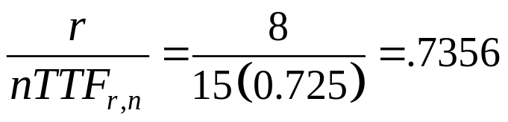
Example 13.10
Given n = 15 and r = 8:
without replacement with replacement
CFR model: f_{8,15} = TTF_{8,15} / TTF_{8,8} f_{8,15} = 8/15 = .533
= .725/2.718 = .2667
Weibull f_{8,15} = (.725/2.718)^{1/2} f_{8,15} = (8/15)1/2 = .730
(Beta = 2) = .516
replacing vs not replacing failed units:
Chapter 13
Notes:
Here are examples of the fraction of reductions in test time as a result of adding more units on test while keeping the number of failures constant. Greater reductions in test time are obtained if failed units are replaced.

Slide 24
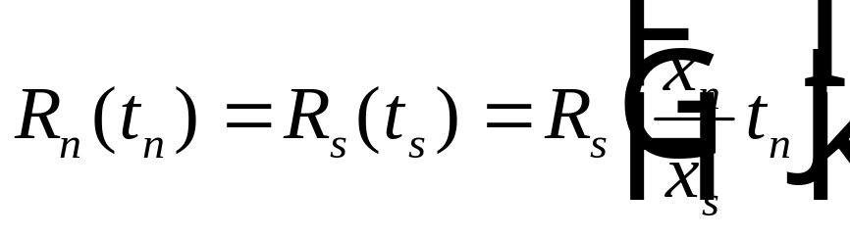
Accelerated Cycling
for products that do not operate continuously or nearly continuously
x_{n} = the nbr of cycles per unit of time under normal cycling,
x_{s} = the nbr of cycles per unit of time under accelerated cycling,
t_{n} = time to failure under x_{n} cycles per unit of time
t_{s} = time to failure under x_{s} cycles per unit of time
x_{n} t_{n} = x_{s} t_{s}
e.g. 10 cycles/hr x 100 hrs = 50 cycles/hr x 20 hrs = 1000 cycles
Chapter 13
Notes:
When time to failure is measured in cycles, accelerating the number of cycles per unit of time will reduce the “clock” time to failure. The accelerated “clock” time to failure is the ratio of the accelerate time between cycles to the normal time between cycles multiplied by the normal “clock” time to failure. For example, if the normal cycle occurs every 3 minutes and an accelerated cycle occurs every minute, then the accelerated “clock” time to failure is 1/3 the normal “clock” time.

Slide 25
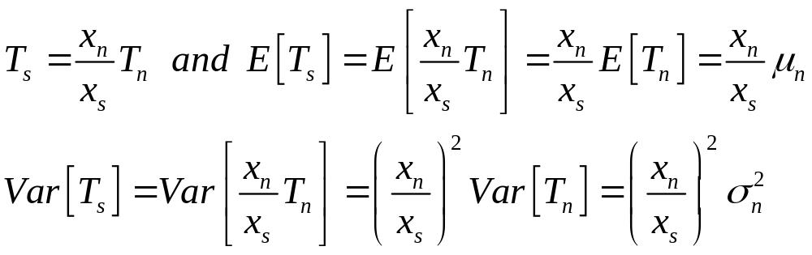
An Observation
Let T_{s} = a random variable, the time to failure under accelerated cycling
T_{n} = a random variable, the time to failure under normal cycling
Chapter 13

Slide 26
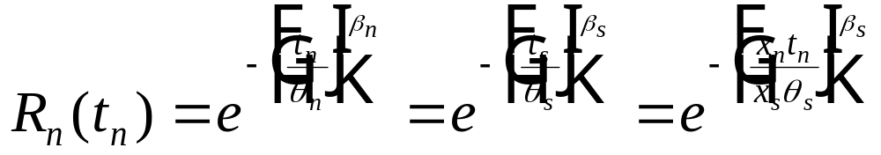
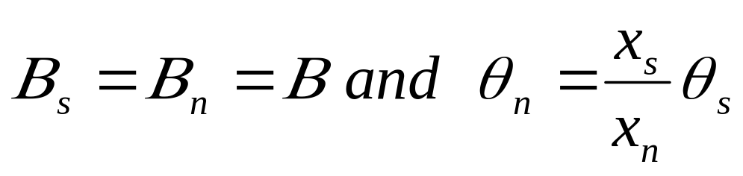
Accelerated Cycling
for Weibull:
Chapter 13
Notes:
Since accelerated cycling is a linear transformation on time, the effect on the Weibull distribution is to reduce the characteristic life. The shape parameter is not affected.

Slide 27
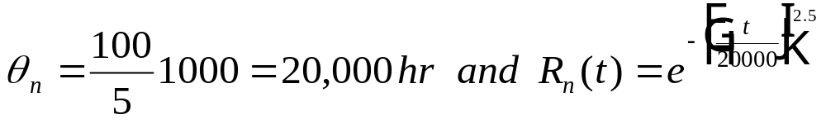

Example 13.11
At automotive part was tested at an accelerated cycling level of
100 cycles per hour. The resulting failure data was found to have
a Weibull distribution with beta = 2.5 and theta_{s} = 1000 hours.
If the normal cycle time is 5 per hour, then
Chapter 13
Notes:
An accelerated cycle example with a Weibull failure distribution.

Slide 28
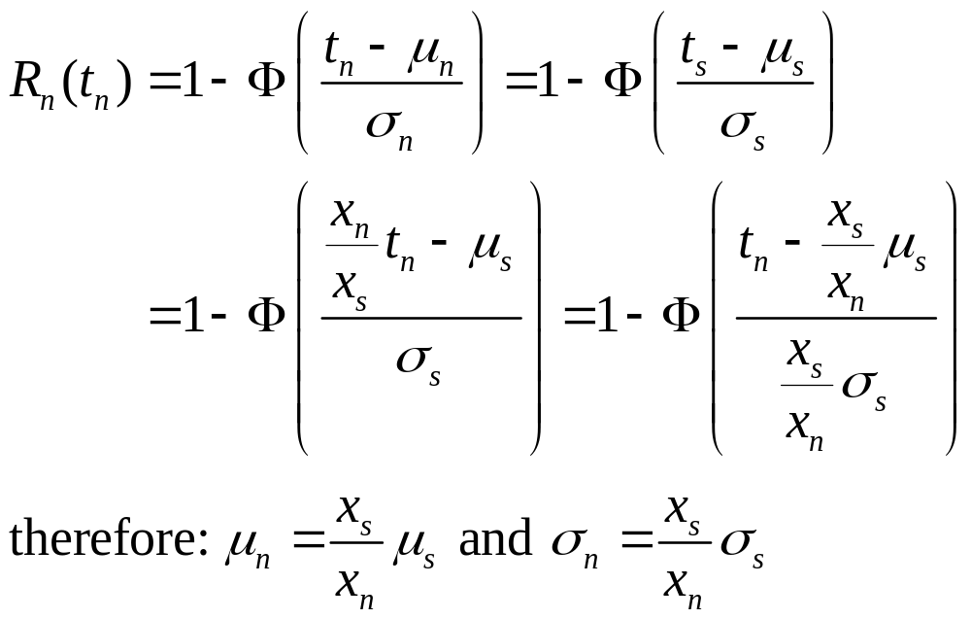
Accelerated Cycling and the Normal Distribution
Chapter 13

Slide 29
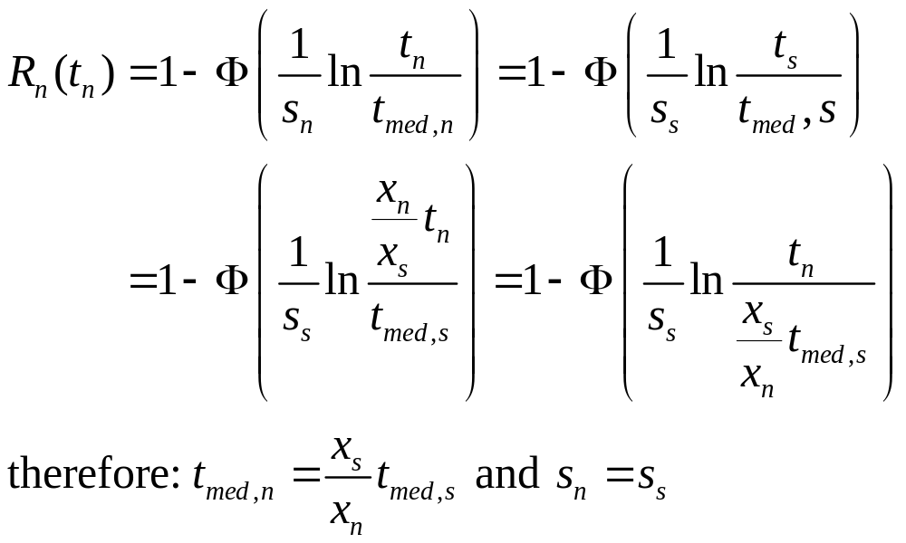
Accelerated Cycling and the LogNormal Distribution
Chapter 13

Slide 30
Constant Stress Models
Basic assumption: same failure mechanisms will be present
at the higher stress levels and will act in the same manner as
at normal stress levels.
t_{n} = time to failure under normal stress
t_{s} = time to failure at high stress level
then t_{n} = AF x t_{s} where AF is an acceleration factor
Therefore
Pr{T_{n} < t_{n} } = F_{n} (t_{n} ) = Pr{T_{s} < t_{s} } = F_{s} (t_{n} /AF)
Chapter 13
Notes:
If cyclical acceleration is not possible, then an alternative approach for accelerating failures is to increase the stress levels that generate the failures. This is always risky because higher stress levels may introduce new failure modes or change the shape of the failure distribution of existing failure modes. The above assumption, therefore, is a critical one.
A constant stress model assumes that the normal time to failure is a constant (the acceleration factor) times the higher stress level time to failure.

Slide 31
Failure Mechanisms and Stresses
Failure Mechanism | Accelerated Stresses
Thermal crack propagation | Temperature, dissipated power
Corrosion | Temperature and humidity
Cyclical (mechanical) fatigue | Cyclical vibration (stress amplitude and load frequency)
Thermal fatigue | Temperature cycling
Electro migration Stress-strength Adhesive or abrasive wear | Current density & temperature Critical load and load frequency Loading, surface area, duration
Test plans:
1. What type of stresses?
2. What stress levels?
3. What number to test at each stress level?
Chapter 13

Slide 32
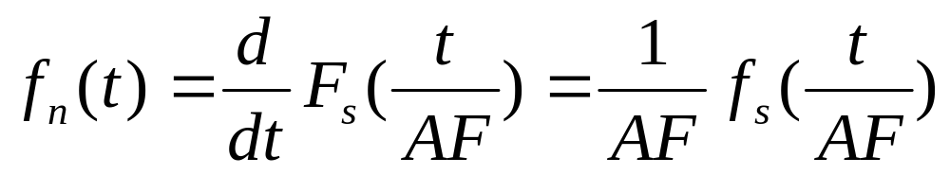
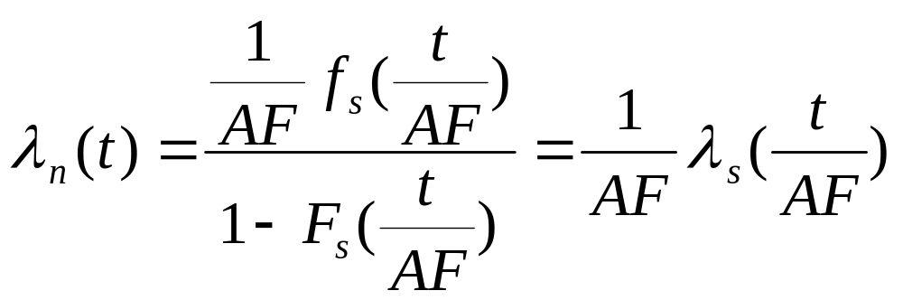
Constant Stress Models
Given F_{n} (t_{n} ) = F_{s} (t_{n} /AF)
Chapter 13
Notes:
Under the constant stress model, the normal stress density function and hazard rate function are related to the higher stress functions as shown.

Slide 33
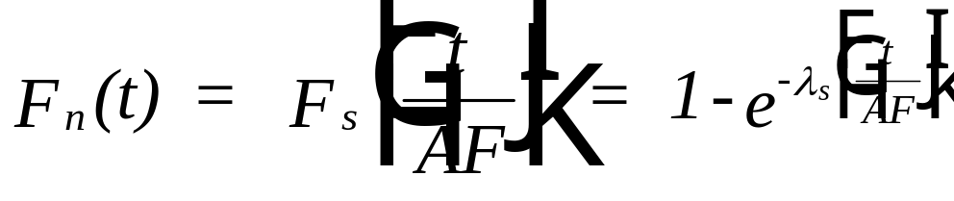
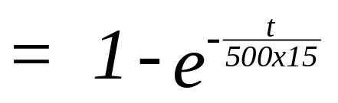
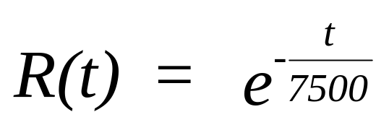
Example 13.12
For the CFR model, a component is tested at 120°C and found
to have an MTTF = 500 hours. Normal use is at 25°C.
Assuming AF = 15, determine the components MTTF and
reliability function at normal stress levels.
and MTTF = 7500 hr.
Chapter 13
Notes:
If the acceleration factor is known, its application is straight-forward as shown in the above example.

Slide 34
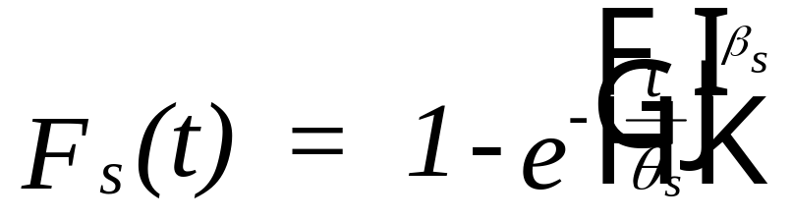
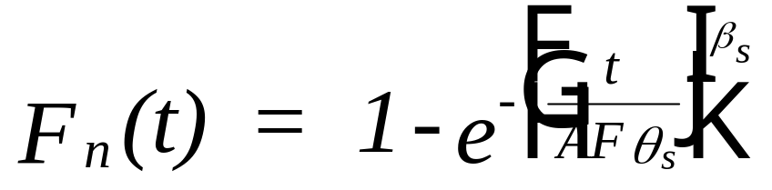
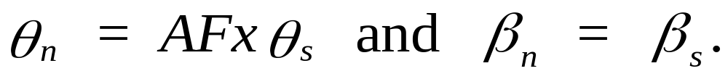
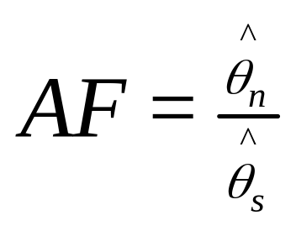
Weibull Case
estimate AF by:
Chapter 13
Notes:
For the Weibull failure distribution, when using the constant stress model only the characteristic life is affected. If theta can be estimated at the normal stress level and then at the higher stress level, the acceleration factor can be estimated by forming the ratio of the two thetas.

Slide 35
An Approach
Location parameter (θ, 1/λ, t_{med})
Least-squares fit
Normal
Stress level
Stress level
Chapter 13

Slide 36


Example 13.15
Accelerated life testing for fracture stress failures at high temperature was conducted on 40 units at four different accelerated stress levels with the following results in hours:
stress level* | 7 | 8 | 9 | 10
sample | time to fail | time to fail | time to fail | time to fail
1.0 | 4355 | 1677 | 784 | 1067
2.0 | 4951 | 4707 | 1813 | 681
3.0 | 7503 | 2407 | 2240 | 1339
4.0 | 1475 | 1367 | 2731 | 1151
5.0 | 4703 | 5709 | 1533 | 1436
6.0 | 5002 | 2976 | 1639 | 507
7.0 | 4091 | 2343 | 1979 | 1174
8.0 | 2514 | 2879 | 1612 | 655
9.0 | 4775 | 3551 | 1233 | 1156
10.0 | 1898 | 2804 | 1705 | 773
*stress levels are measured in psi
Chapter 13
Notes:
Shown are the result of a Weibull example where two reliability life tests are conducted with one at the normal stress level and one at the higher stress level. From the two data sets, the acceleration factor is estimated. Although the shape parameter estimates will not necessarily be identical (although they are in this example), they should be “close” to one another. If they are not, then the assumption that the higher stress does not change the shape of the failure mechanism is incorrect, and the constant stress model should not be applied.

Slide 37
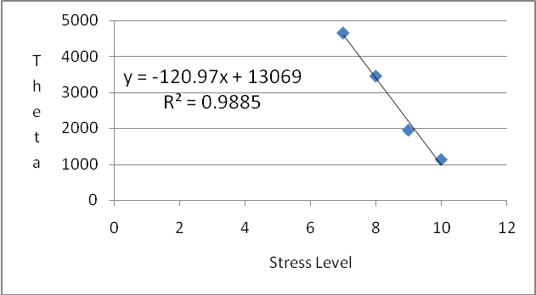
Example 13.15
stress level | 7 | 8 | 9 | 10
β | 2.7 | 2.5 | 3.2 | 3.1
θ | 4647 | 3445 | 1938 | 1117
Chapter 13
Notes:
Once the acceleration factor has been estimated, then a larger sample size may be obtained at the higher stress level resulting in a more accurate estimate for the distribution parameters.

Slide 38
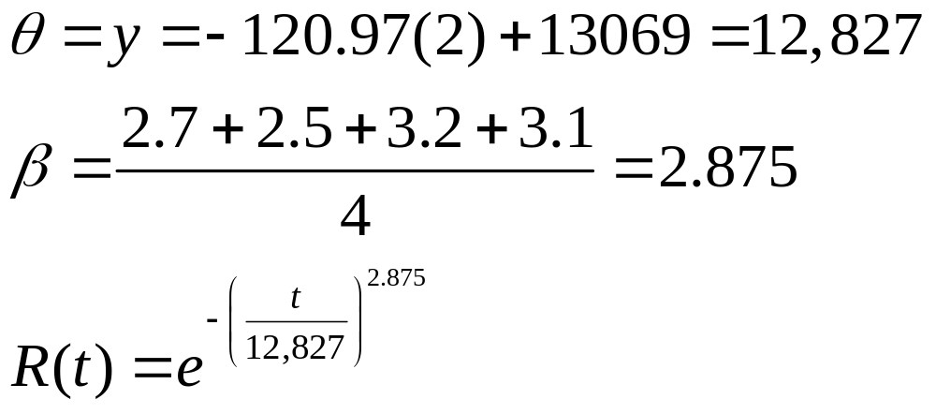
Example 13.15
At the normal stress level of 2 psi, θ = 12,827 hr. Using the average of the four β values, the reliability model at the normal stress level (2 psi) becomes:
Chapter 13

Slide 39
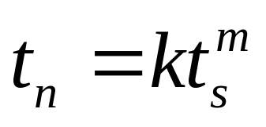
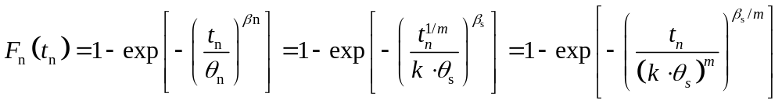
Nonlinear stress effects
Assume , m ≠ 1.
both the scale and shape parameters change
Chapter 13

Slide 40
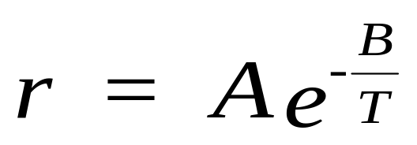
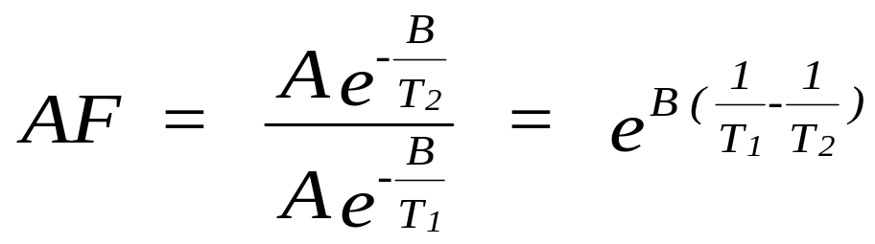
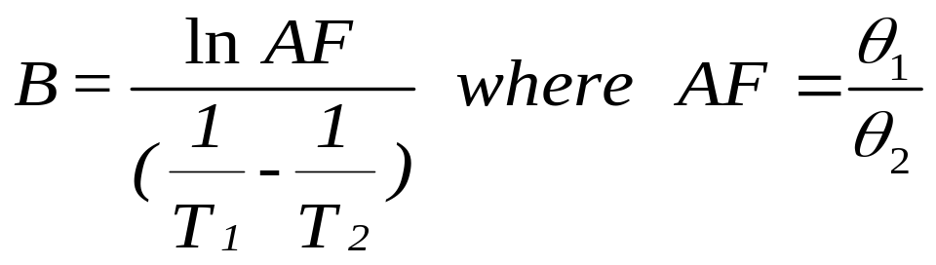
Arrhenius Model used when increased temperature is the applied stress
where r is the reaction or process rate, A and B are constants,
and T is temperature measured in degrees Kelvin
Chapter 13
Notes:
Some important failure mechanisms such as those resulting from chemical reactions are based upon the idea that a failure occurs after some critical level of transformation has occurred. Therefore
time to failure = critical level / transformation rate
The Arrhenius model assumes that the transformation rate is dependent upon temperature as shown. B is a constant, the coefficient of reaction. The constant A depends upon the component and the failure mechanism and is determined empirically. The constant B can be estimated by testing at two temperature stress levels to obtain the acceleration factor.

Slide 41
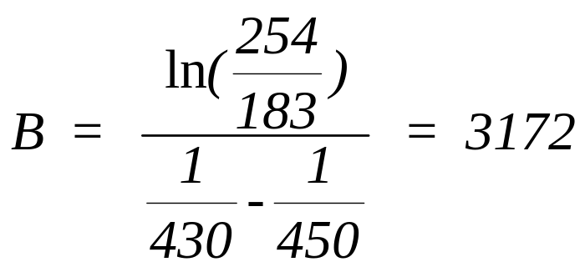
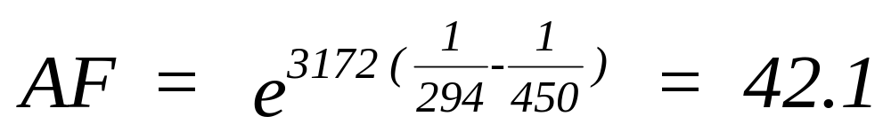
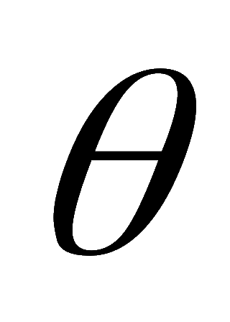
Example 13.14
An electronic component has a normal operating temperature of
294° K (about 21° C). Under stress testing at 430° K a Weibull
distribution was obtained with theta = 254 hours, and at 450° K., a
Weibull distribution was obtained with theta = 183 hours.
The shape parameter did not change with beta = 1.72.
normal temperature
Weibull with a shape parameter of 1.72
and = 42.1 x 183 = 7704.3 hours.
Chapter 13
Animated
Notes:
The above example uses the Arrhenius model at two high stress levels to obtain the constant B and then estimates the distribution at the normal stress level by finding the AF between a high temperature (stress level) and the normal temperature.

Slide 42
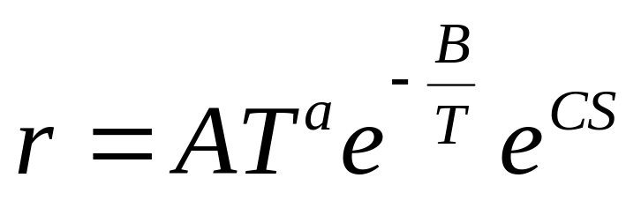

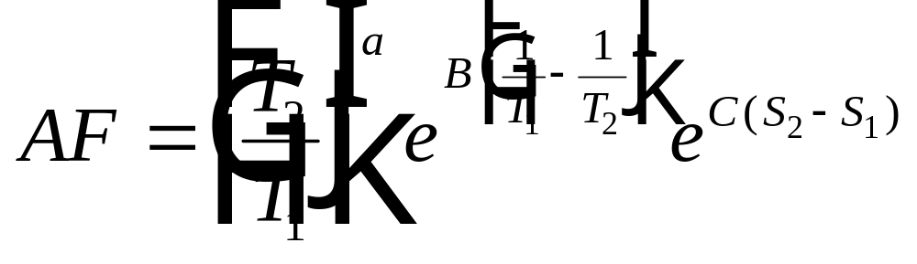
Eyring Model
A, , B, and C are constants to be estimated
Chapter 13
Notes:
The Eyring model assumes that the transformation rate is dependent upon both the temperature and a second stress factor represented by S. The constants a, A, B, and C must be estimated by generating data at different temperature and stress (S) levels. The model can then be used to determine the AF between high stress levels and normal stress levels. Presumably all testing would be done at the high stress levels.

Slide 43

Degradation Models
y = a - b t , where y is the performance measure, a and b are
constants to be determined experimentally, and t is the amount
time the product is exposed at a constant stress level
time to failure, t_{f} :
where y_{f} is the performance level at which a failure occurs
Chapter 13
Notes:
For components that degrade uniformly over time, the rate of degradation can be measured. Its failure time is then obtained by extrapolating to the time at which the component has degraded to an unacceptable level.

Slide 44
Degradation Models-assumptions
Not reversible - monotonic decrease in performance
single degradation process
prior to testing degradation is negligible
measurement error is negligible
Chapter 13
Notes:
To apply a degradation model, the above assumptions must be met.

Slide 45


Example 13.15
t = exposure time in hours,
w(t) = weight loss due to corrosion after t hours exposure in mg
= density of the material in grams per cubic centimeter
A = exposed surface area in square centimeters
k = 87.6, a constant which converts CPR to millimeters per year
If l_{f} is the allowable loss in millimeters after which the material
is no longer structurally sound, then the time to failure is
projected to be
t_{f} = l_{f} / CPR
Chapter 13
Notes:
A good example of degradation is a corrosive process. CPR is the corrosion penetration rate. It is the rate of material loss (thickness) per unit time. Values for w(t) are obtained through laboratory testing.

Slide 46


Example 13.16
where p = potency of the drug
r = rate of chemical reaction
t = drug exposure time
then t = - ln p / r
Chapter 13
Notes:
The potency of pharmaceuticals degrades over time. The rate of degradation depends upon the temperature the drug is stored at. Using the Arrhenius model with temperature as a stress factor, then the time to failure can be estimated by specifying a minimum potency level for the drug. The constants A and B can be estimated from test data generated at two different temperature (stress) levels.

Slide 47


Cumulative Damage Models
Minor’s rule:
t_{i} = the amount of time at stress level i
L_{i} = the expected lifetime at stress level i
Chapter 13
Notes:
Minor’s rule, given above, provides an alternative acceleration model when continuous wear will eventually lead to failure.

Slide 48


Cumulative Damage Models
3. solve
1. test to failure
2. test to t₁ then to failure t₂
Chapter 13
Notes:
Shown is a graphical illustration of the use of Minor’s rule. The approach is to test to failure at a high stress level to obtain one point on the line (0,L₂). Then test at the normal stress level for some time, t₁. Then at the high stress level test to failure occurring at time t₂. This gives a second point on the line (t₁, t₂). Extrapolating the line to the horizontal axis, gives the time to failure under normal stress.

Slide 49


The End of Chapter 13
I have found this discussion to be quite stress full
I feel I have degraded in an accelerated way!
Chapter 13
Notes:
The end.

